Slide 1

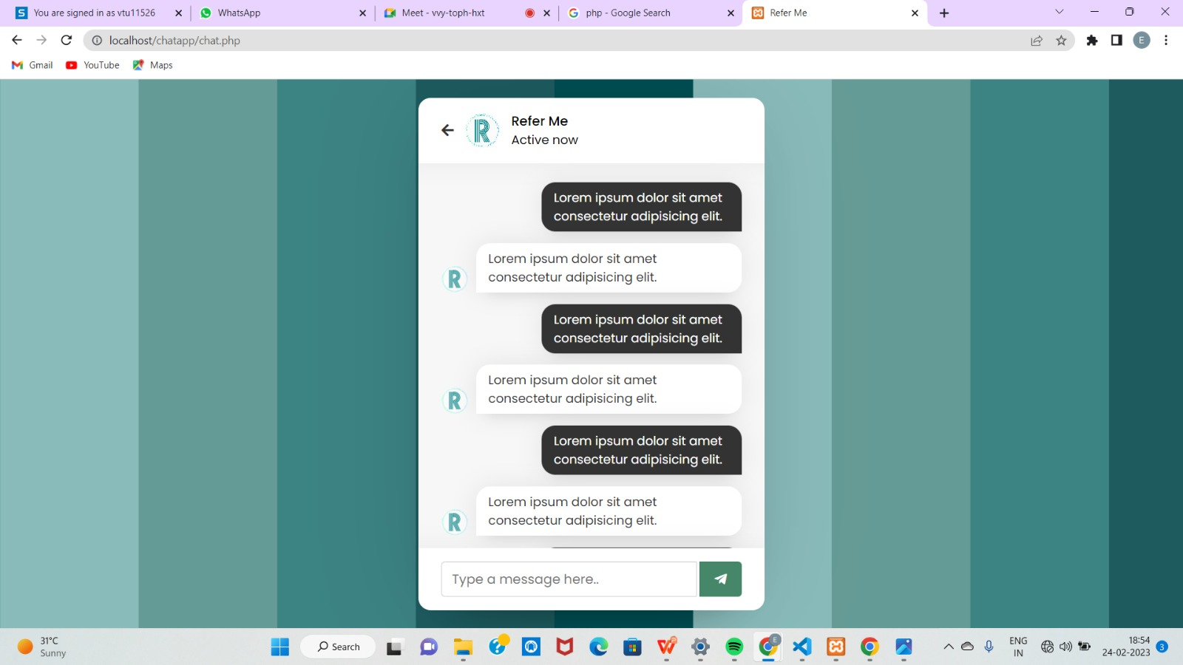
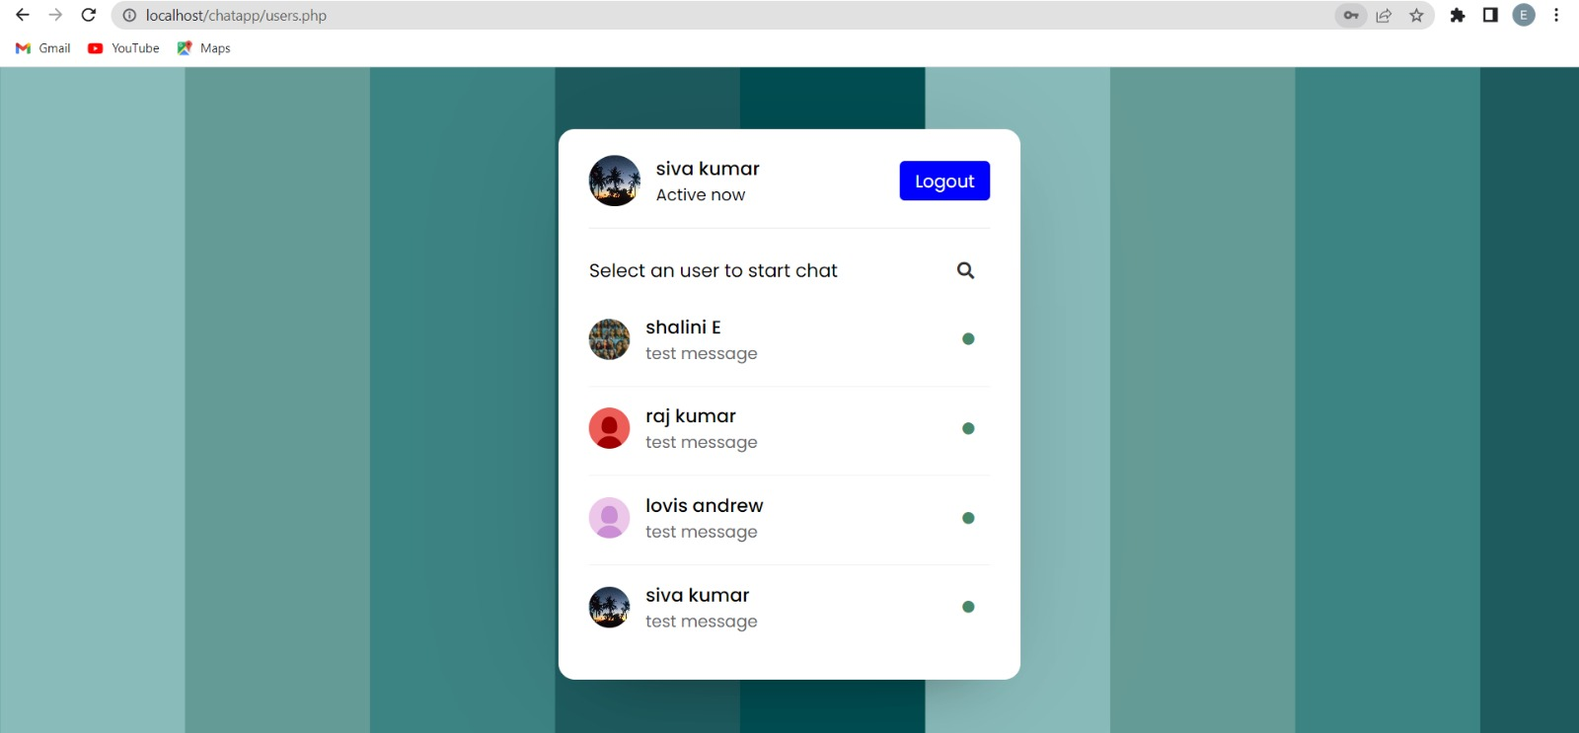
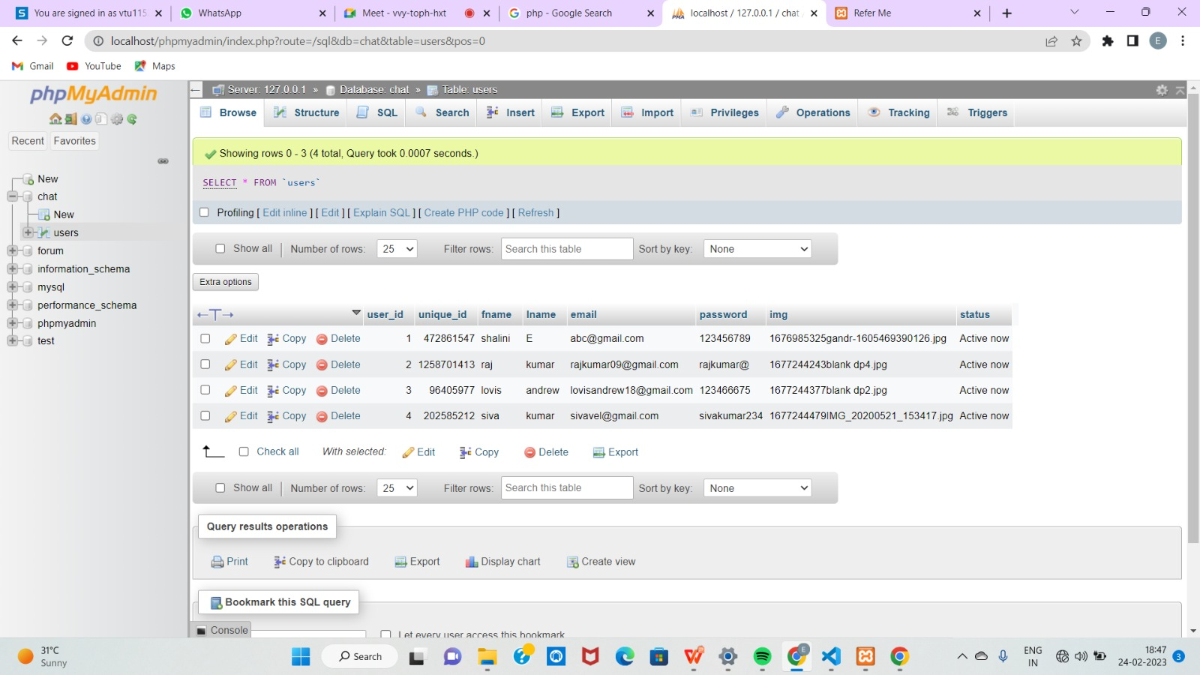
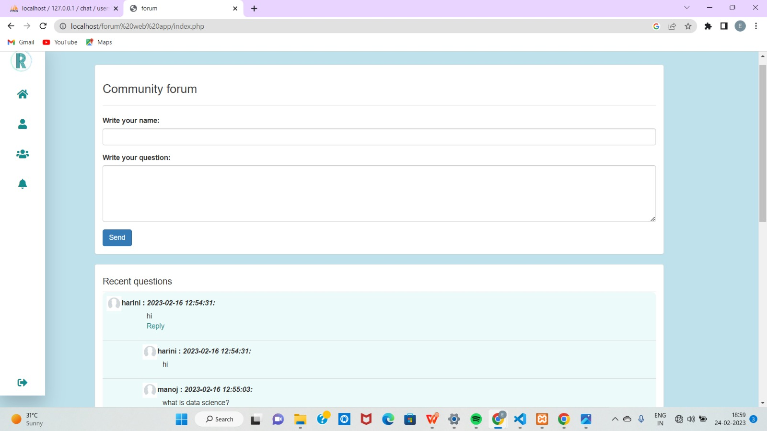
WEB-BASED ONLINE DISCUSSION FORUM APPLICATION
Department of Computer Science & Engineering
School of Computing
1156CS701 – MAJOR PROJECT
WINTER SEMESTER 2022-2023
ABSTRACT
INTRODUCTION
RESULTS
STANDARDS AND POLICIES
Online group discussion forum application has been around for several years.It is a web application where students can post their doubts and they can also clarify their doubts by other users and also user can view the previous discussion taken place on that day.It is difficult to note down all the problems manually so by using online discussion forum application they can clarify their doubts easily and faster.
The project named “WEB-BASED ONLINE DISCUSSION FORUM APPLICATION” by creating account in this application the students can share their ideas and they can also make decission on various topics. Its technically a discussion form where users(students) can clear their doubts by posting questions and also they can learn other topics by reading live conversation or by reading the previous conversations. Eventhough there are many forum applications are aldready there like brainly, quara etc. Each applications has their own demerits for students to use. So,we creating the application which will make more comfortable for the students to use.
Online discussion forums can yield a variety of results, both positive and negative. On the positive side, forums can facilitate knowledge sharing, networking, and community building among users. They can also foster critical thinking and help users develop their communication and writing skills. Additionally, forums can serve as valuable sources of feedback and insights for businesses and organizations, allowing them to better understand their customers and improve their products or services. On the negative side, forums can also be breeding grounds for misinformation, harassment, and toxic behavior. Therefore, it is important for forum applications to implement effective moderation tools and policies to maintain a healthy and productive discussion environment.
Visual Studio Code
Visual Studio code,also commonly referred to as VS Code,is a source-code editor made by Microsoft for Windows,Linux and macOS.Features include support for debugging, syntax highlighting, intelligent code completion, snippets, code refactoring and embedded git. Users can change the theme,keyboard shortcuts,preferences and install extensions that add additional functionality.
Standard Used: ISO/IEC 6429
XAMPP
XAMPP is an open-source web server solution that provides an easy-to-use platform for developers to create and test web applications locally. XAMPP has its own set of standards and policies that ensure the security and stability of the platform. These policies include regular updates to keep the platform up-to-date with the latest security patches and software versions, a strict access control system to limit access to sensitive data and resources, and a comprehensive backup system to protect against data loss. Additionally, XAMPP has a strong commitment to user privacy and data protection, and provides detailed documentation and support to ensure that developers can use the platform safely and effectively.
Standard Used: ISO/IEC 12207
Table 1. forum disscusion database
TEAM MEMBER DETAILS
Figure 1. search users
Figure 2. Chat box
CONCLUSIONS
<Student 1. 12596/Manojh Kumar S>
<Student 2 .vtu 11514/Shalini E>
<Student 3 .vtu 13669/Harini Nesapriya M>
<Student 1. 8825894732>
<Student 2. 82703 81967>
<Student 3. 93440 86928>
<Student 1. vtu12596@veltech.edu.in>
<Student 2. vtu11514@veltech.edu.in>
<Student 3. vtu13669@veltech.edu.in>
METHODOLOGIES
The Web based online disscusion forum application is used to serve as a channel through which the students can share their opinions and can also clarify their doubts by viewing the previous conversation based on the topic. The forum application also ensures the participation of the students in various activities and events to create a healthy environment.
Forum applications typically employ a variety of methodologies to enable users to engage in online discussions. These methodologies include user authentication and authorization, thread creation and management, comment and reply mechanisms, moderation tools, and search functionality. In addition, forum applications may also implement features such as user profiles, private messaging, notifications, and gamification elements to enhance user engagement and retention. Overall, the methodologies employed by forum applications aim to provide users with a seamless and enjoyable experience while facilitating meaningful discussions and fostering community building
ACKNOWLEDGEMENT
Project Supervisor Name/Designation: Dr.Angeline Lydia
Project supervisor Contact No: +91 75400 98415
Project supervisor Mail ID: drangenilelydia@veltech.edu.in
Chart 1. Forum page

